Slide 1
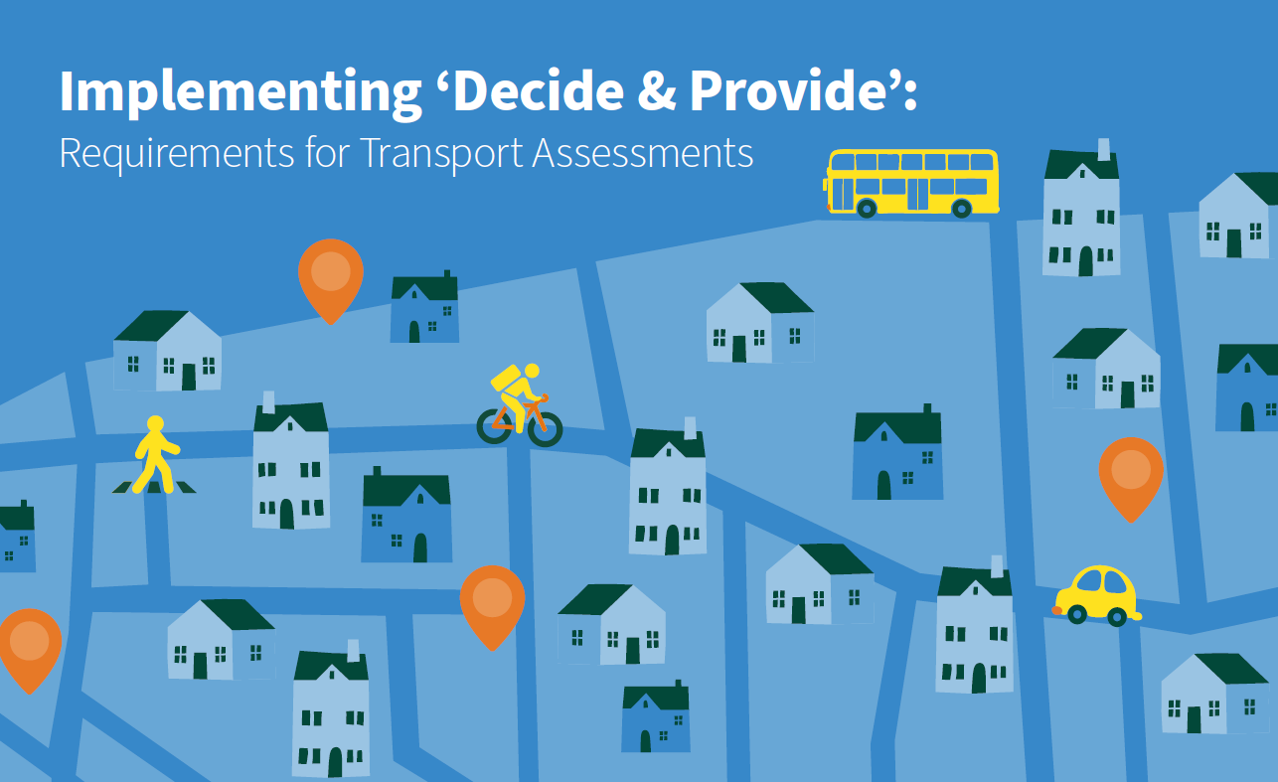
Implementing Decide & Provide: Requirements for Transport Assessments
TRICS User Meeting November 2023
Will Pedley
Transport Planning Technical Lead
Oxfordshire County Council

Slide 2
Structure of today’s session
Implementing Decide & Provide: Requirements for Transport Assessments
OCC’s Local Transport and Connectivity Plan and policy context
Development of the document and its role as part of other planning processes
Legislation and policy context: National Planning Policy Framework
Illustrative example of the traditional versus the new approach
Overview of the step-by-step process for transport assessments
Initial experiences, potential issues, and next steps

Slide 3


Implementing Decide & Provide: Requirements for Transport Assessments
OCC’s Local Transport and Connectivity Plan and policy context
OCC’s Local Transport and Connectivity Plan (LTCP) ‘at a glance’:
The LTCP outlines a clear vision to deliver a net-zero Oxfordshire transport and travel system that enables the county to thrive whilst protecting the environment and making Oxfordshire a better place to live for all residents. We plan to achieve this by reducing the need to travel, discouraging individual private vehicle journeys and making walking, cycling, public and shared transport the natural first choice. The policies included in the LTCP are the tools that we believe are necessary to achieve this.
This approach is captured in LTCP Policy 36, which states that OCC will:
The ‘Implementing Decide & Provide’ document is based on guidance that TRICS has produced, called the ‘Guidance Note on the Practical Implementation of the Decide & Provide Approach’ (2021) with further detail and requirements provided relevant to the LTCP.
This new approach still requires proposed developments to assess their potential transport impact on the highway network, but instead of basing this solely on previous travel patterns, they will be required to model a range of plausible scenarios. Additionally, their transport impacts will need to be monitored and managed over time.
  Only consider road capacity schemes after all other options have been explored.
  Where appropriate, adopt a decide and provide approach to manage and develop the county’s road network.
  Assess opportunities for traffic reduction as part of any junction or road route improvement schemes.
  Require transport assessments accompanying planning applications for new development to follow the County Council’s ‘Implementing ‘Decide & Provide’: Requirements for Transport Assessments’ document.
  Promote the use of the ‘decide and provide’ approach in planning policy development to support site assessment.

Slide 4
Implementing Decide & Provide: Requirements for Transport Assessments
Pathway towards the development of the document
Project start: December 2021
Emerging Local Transport and Connectivity Plan
Service Improvement
Plan
TRICS guidance review
First draft of OCC’s document
Regular meetings with portfolio holders
LTCP adoption July 2022
Engagement with district colleagues and private sector
Second draft of OCC’s document
Internal stakeholder engagement
Regular meetings with portfolio holders
Final draft of OCC’s document
Cabinet adoption September 2022
Briefing sessions, implementation in practice

Slide 5
Implementing Decide & Provide: Requirements for Transport Assessments
The role of this document as part of other planning processes
This document forms only one part of the means necessary to achieving the aims of the LTCP. The Parking Standards for New Developments, the forthcoming LTCP corridor and area strategies, and the Street Design Guide will all help to implement the strategic approach set out in the LTCP.
Although individual sites have an important role to play in decarbonising the transport network, this aim will not be most effectively achieved by only addressing transport needs on a site-by-site basis, rather a comprehensive and wide-ranging approach is necessary.
The forthcoming local plans will need to allocate development where there are the best opportunities for reducing the need to travel by co-locating residential and employment uses, or where exists the best opportunities for providing high-quality active and sustainable transport connectivity.
It is critical to ensure that these principles promoted by OCC in the LTCP are appropriately referenced within the core policies of the forthcoming local plans, as these carry greater weight in planning decisions than the LTCP does by itself.
Local Transport and Connectivity Plan: Part One
District and City
Local Plans
LTCP Part Two: corridor and area strategies
Towards a net-zero
transport system
Implementing ‘Decide & Provide’
Street Design Guide
Parking Standards for New Developments

Slide 6
Implementing Decide & Provide: Requirements for Transport Assessments
Legislation and policy context: National Planning Policy Framework
The NPPF: Some of the helpful bits…
“opportunities to promote walking, cycling and public transport use are identified and pursued” (paragraph 104)
“Significant development should be focused on locations which are or can be made sustainable, through limiting the need to travel and offering a genuine choice of transport modes.” (paragraph 105)
“safe and suitable access to the site can be achieved for all users” (paragraph 110)
The NPPF: Some of the not so helpful bits…
“Development should only be prevented or refused on highways grounds if there would be an unacceptable impact on highway safety, or the residual cumulative impacts on the road network would be severe.” (paragraph 111)
“Planning obligations must only be sought where they meet all of the following tests:
  necessary to make the development acceptable in planning terms;
  directly related to the development; and
  fairly and reasonably related in scale and kind to the development” (paragraph 57)
Decide & Provide process for Transport Assessments
Translates connectivity improvements into anticipated modal shift to address identified transport issues
In turn, this articulates their efficacy in the context of how decisions are made under the NPPF
Predict and Provide enabled more simplified means of identifying issues and highway capacity ‘solutions’
Decide and Provide unavoidably more complex but will yield better, more progressive outcomes

Slide 7
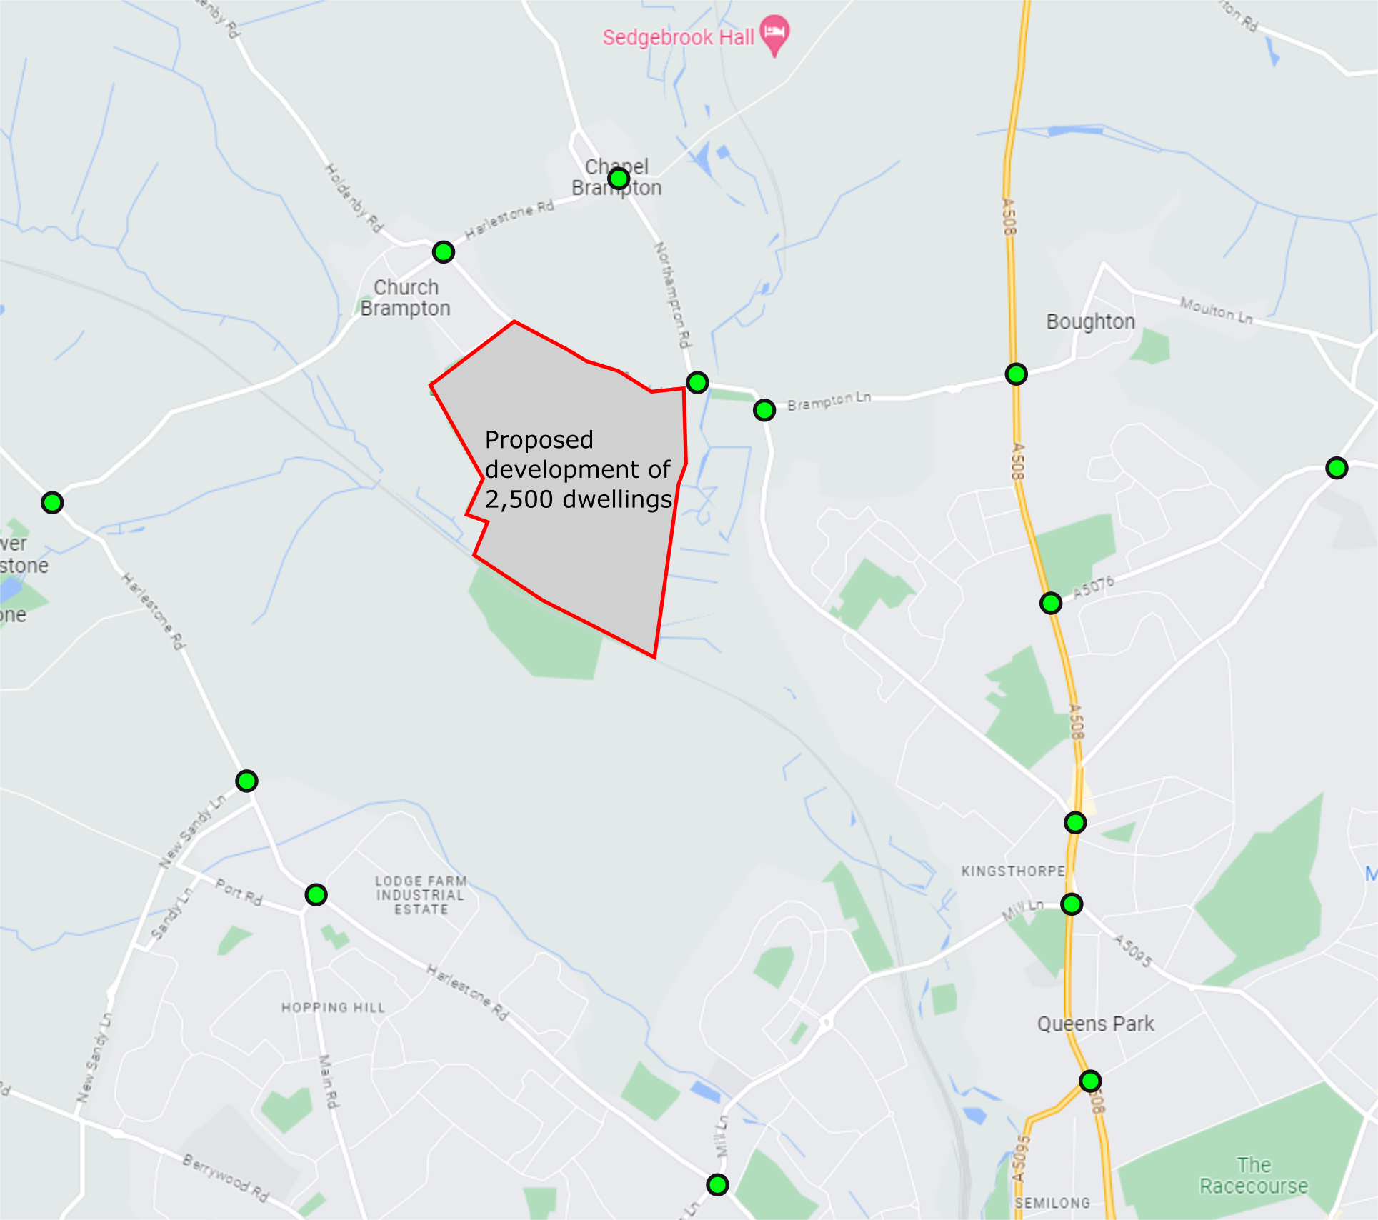
Implementing Decide & Provide: Requirements for Transport Assessments
Illustrative example of the traditional versus the new approach
Traditional approach to transport assessments
Vehicular trip rates expected to be generated by the proposed development would be used from TRICS, which is a database of traffic surveys from across the UK, using comparable sites based on historic travel patterns;
For example, this may result in a trip rate of 0.4, meaning 1,000 vehicle trips in the peak hours generated by a development of 2,500 dwellings;
The impact of these trips would then be modelled on the highway network, potentially leading to junctions forecast to be over capacity in future years (see illustrative study area on map opposite);
Resulting from that assessment, capacity improvements for vehicles would have been identified at the junctions on the map to address congestion; and
Small-scale improvements to off-site walking and cycling provision might also have been identified accompanied by financial contributions secured for improved bus services.
Decide & Provide approach to transport assessments
As with the traditional approach trip rates would be derived from TRICS, or suitable alternative data sources, based on existing site characteristics and these resultant impacts then modelled to establish a baseline or a ‘do-minimum’ scenario;
Connectivity characteristics are then assessed, based on the 20-minute neighbourhood principles to inform requirements for high-quality walking, cycling, and public transport improvements;
Where capacity issues have been forecast based on historic vehicle trip rates, ways of addressing these through further sustainable and active travel improvements and the modal shift they are expected to engender must be identified;
A second scenario is then modelled based on a new set of TRICS data (or suitable alternative) from exemplar sites that reflect the proposed development now taking account of the evidenced modal shift effects of all proposed improvements, for example the trip rate is now 0.3, or 750 vehicle trips in the peak hours;
If residual impacts of vehicle trips result in unacceptable levels of congestion (e.g. resulting in air quality or safety issues, impacting on bus journey times, etc.), then further improvements would be needed, if these issues cannot fully be addressed through sustainable and active travel improvements some capacity improvements may be required as a last resort; and
Through the S106 legal agreement, travel behaviour is monitored over time to ensure that the trip rates identified in the second scenario materialise, if the necessary modal shift is not achieved, further mitigation may be required.

Slide 8
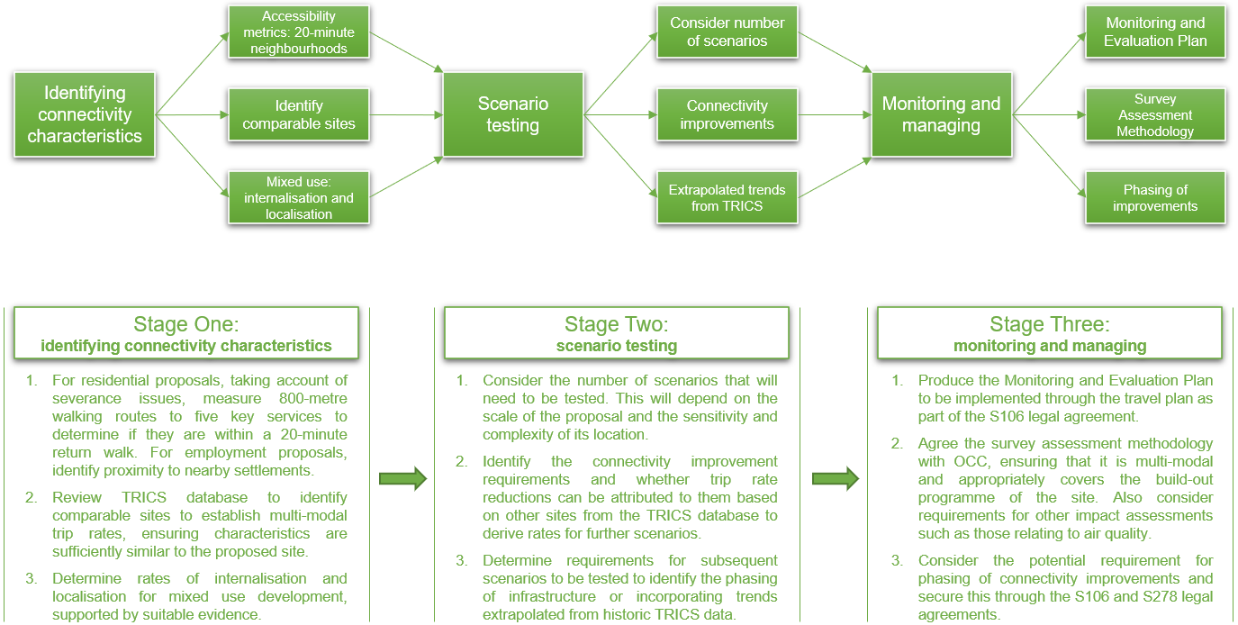
Implementing Decide & Provide: Requirements for Transport Assessments
Overview of the step-by-step process for transport assessments

Slide 9
Implementing Decide & Provide: Requirements for Transport Assessments
Reflections on initial experience of its implementation
Preliminary experiences of implementing the document have been generally positive. Early indications are that the methodology will be a useful tool for securing higher quality public transport and active travel provision.
Interweaving into the modelling process policy requirements that might otherwise be sidelined, it places these matters more centrally in the understanding of transport impacts for all modes, thus aiding negotiations.
Adopting this approach allows us to move away from treating the modelling results of one scenario as infallible and as objective truth when we know that, in reality, outcomes will be uncertain and unknowable.
Through the old approach we had to accept a false precision and a false sense of certainty about future travel patterns. This new approach is unavoidably more complex but will enable more forward-thinking outcomes.
Adopting this approach enables us to paint a more nuanced picture of plausible outcomes and helps to provide a framework within which deliberation can take place thus leading to better informed decision-making.

Slide 10
Implementing Decide & Provide: Requirements for Transport Assessments
Potential issues and next steps
Due to more complex transport assessments being required of developers, this may result in greater demand on staff resource to agree the scope of transport assessments and then review the resultant outputs. Additionally, the outputs of monitoring surveys will need to be reviewed by officers.
Further to this, the potential for greater complexity in S106 legal agreements may have staff resource implications due to the resultant additional time taken to negotiate and draft said legal agreements.
While Decide & Provide is not a new concept, OCC is the first LHA in England to produce its own document requiring transport assessments to follow this process in detail. As such, there will be much to learn and finesse, which can only be done through a process of ‘learning by doing’.
We have had a lot of interest from a number of organisations including Homes England, the Department for Transport, and even the New Zealand Transport Agency.
The document is now being used in practice across the county. It is intended that its contents will be reviewed and refined next year to reflect lessons learned from its implementation.

